Slide 1


Ajou University
2024.12.04
Enhancing Vision Transformer’s Inference Speed
Integrating Hybrid Architectures and Novel Similarity Measures
Department of Software & Computer Engineering
JEONCHAN GANG, HYEONWON NAM, YONGHUN JEONG DONGYEOP HAN

Slide 2
Table of contents
01 Swin Based Approach
01
01
02 LeViT Based Approach
02
02
03 Launcher Architecture
03
03
04 New Ideas
04
04
05 Conclusion
05
05

Slide 3

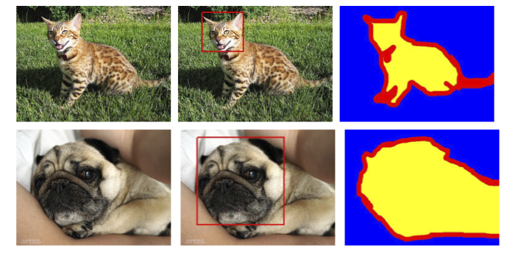
00 Learning Condition
Minimum Performance guaranteed
ImageNet (1000 classes) | Number of Images | Size (GB)
Training | 1,281,167 | 138GB
Validation | 50,000 | 6.3GB
Test | 100,000 | 12.57GB
Batch size : 32
Learning rate : 1e-3
Epoch : 50
Initially, we tried to use ImageNet as Dataset,
but it was too big and no longer supported by Pytorch Dataset library.
Oxford-IIIT Pet (37 classes) | Number of Images | Size (GB)
Training | 3,680 | 0.77GB
Validation | 3,669 | 0.77GB
Test | - | -
Oxford-IIIT Pet (37 classes) | Number of Images
Training | 5,114
Validation | 1,102
Test | 1,103
7 : 1.5 : 1.5
Split
Among the things being supported by Pytorch,
we trained with a smaller dataset, Oxford-IIIT Pet (Pet37).

Slide 4
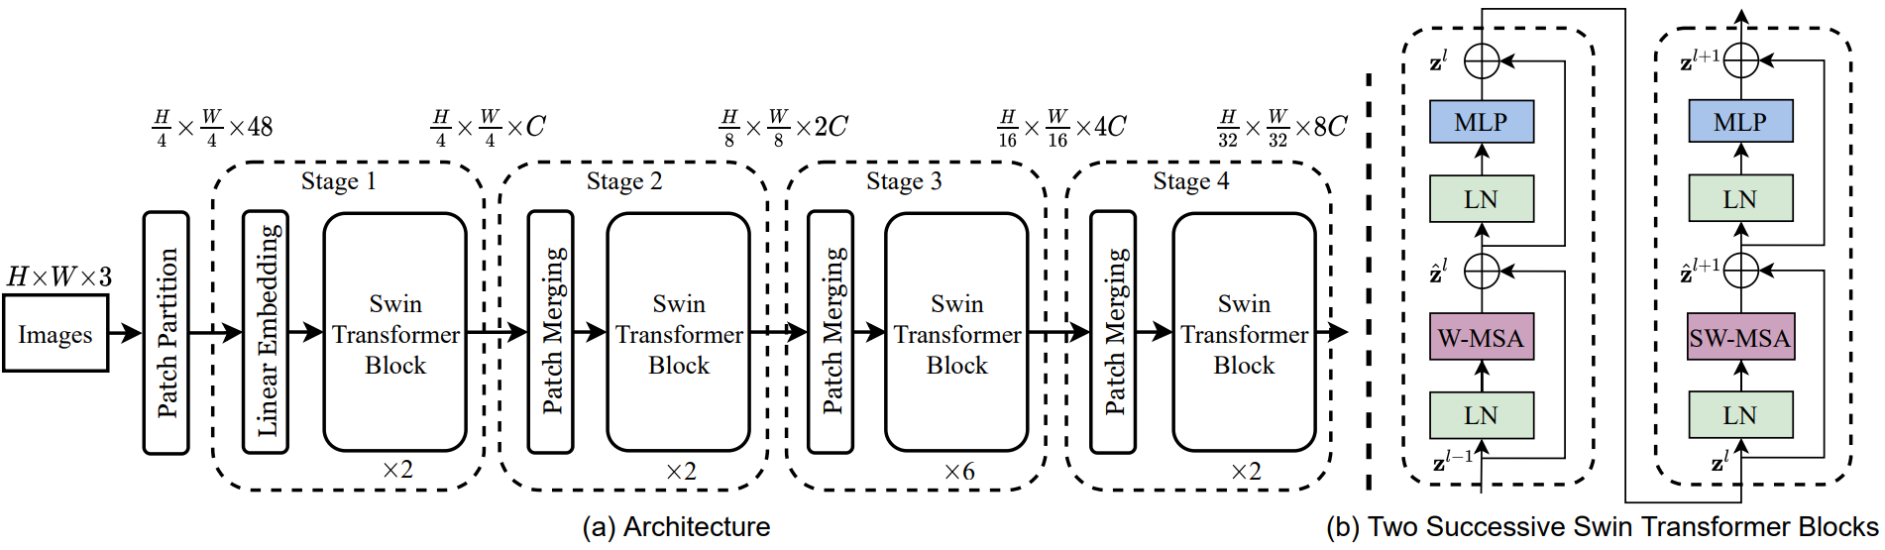
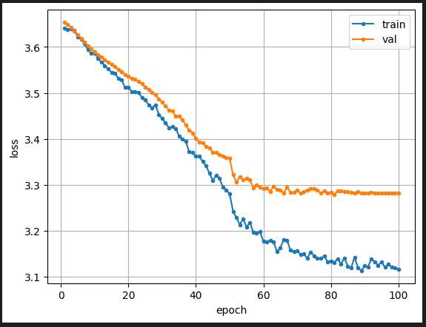
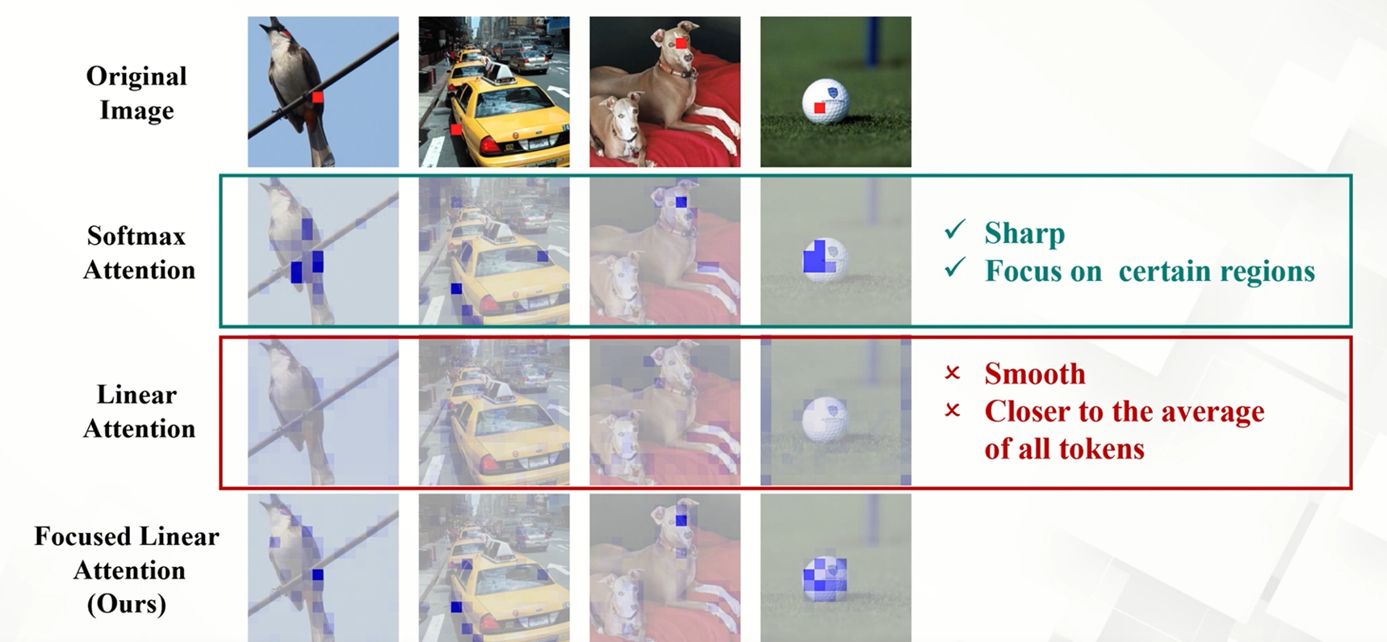
01 Swin Based Approach
Swin + FLatten Transformer
Replaced the self-attention
with focused linear attention.
Overfitting was addressed,
but the model failed to train accurately.
We have tested this combination
with different window sizes, focus factors, etc.

Slide 5
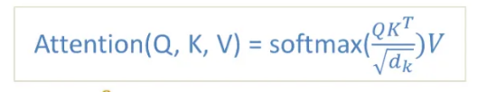
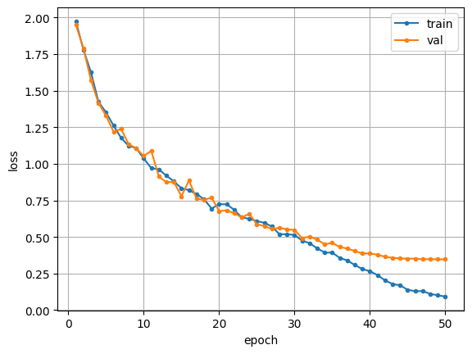
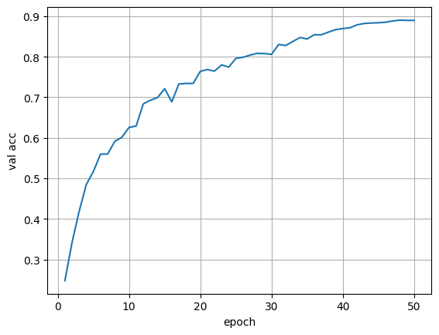
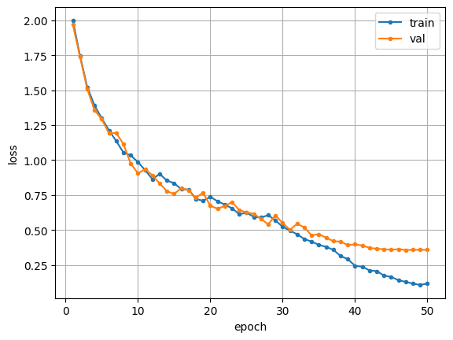
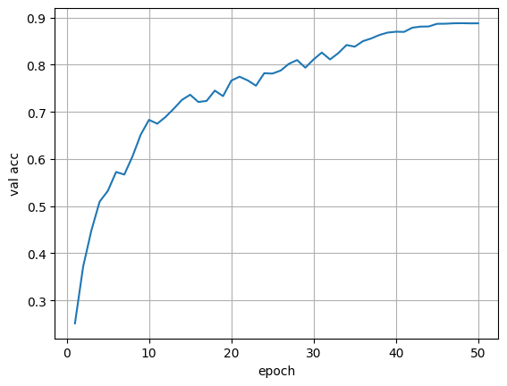
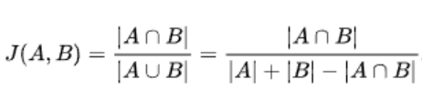
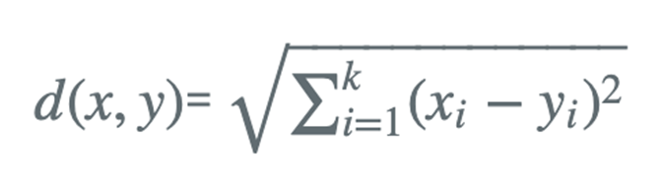
01 Swin Based Approach
We confirmed that the inference time was similar or slightly faster than when using the similarity function using the existing inner product.
This showed better accuracy than original. Loss : 0.394, Acc : 87.9%
Swin + Similarity
Set | Result
Swin + Jaccard | Average inference time : 9.79ms
Swin + Euclidian
Loss : 0.348
Acc : 88.9%
Change similarity of Q and K Measurement of Attention
Jaccard similarity function
2. Euclidian similarity function
Average inference time : 10.83ms
Loss : 0.359
Acc : 88.8%
Average inference time : 9.79ms
Both similarity metrics shows good training without overfitting.
We used CIFAR-10 ( 32 X 32)
Notes:
Proposal 발표에서 보여준 듯이 swin에서 유사도 함수를 교체하였을 때 유클리디안에서 추론시간이 빨라지고,
자카드 유클리디안 둘 다 성능이 약간 개선됨

Slide 6
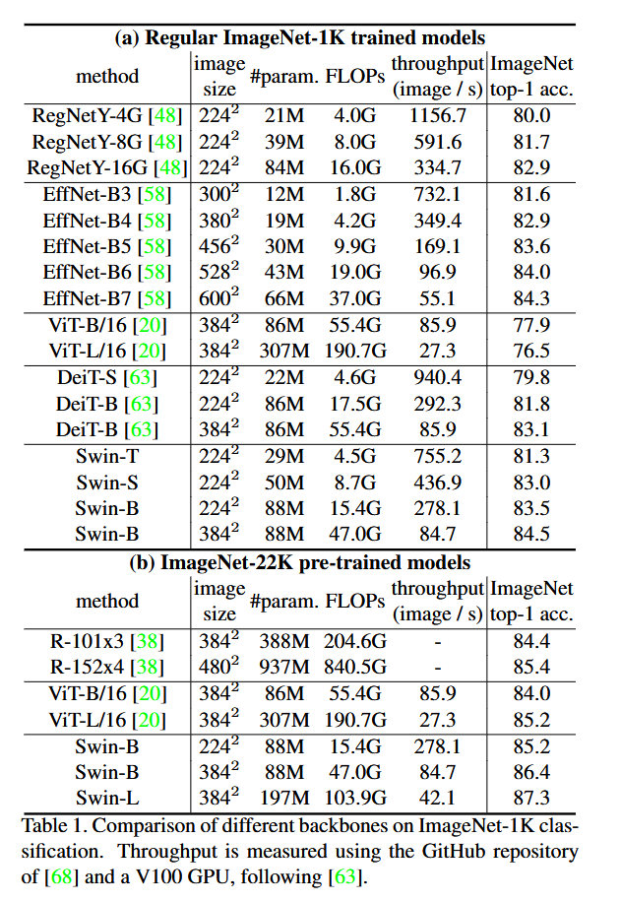
Q: Does Swin improve the inference time?
Swin Transformer was proposed for higher accuracy
compared to the models with similar size, params, throughput.
Since this architecture is not intended for faster inference,
we decided to drop this and moved to LeViT architecture.

Slide 7
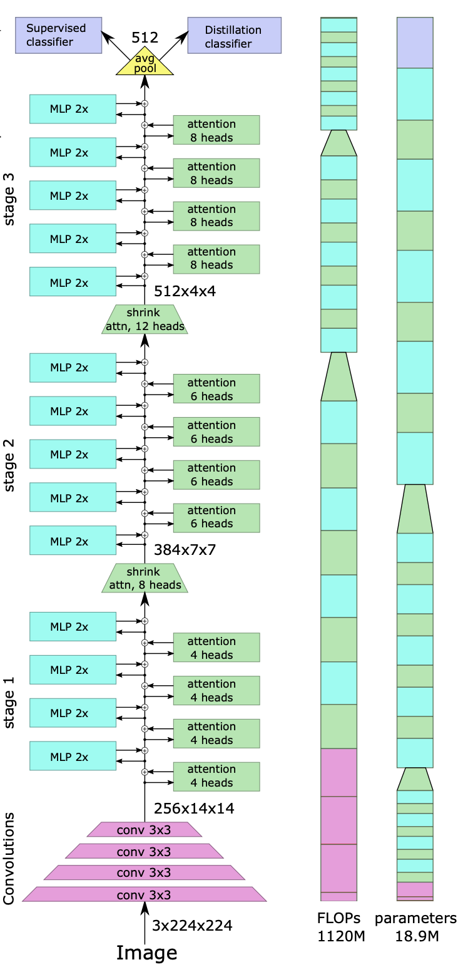
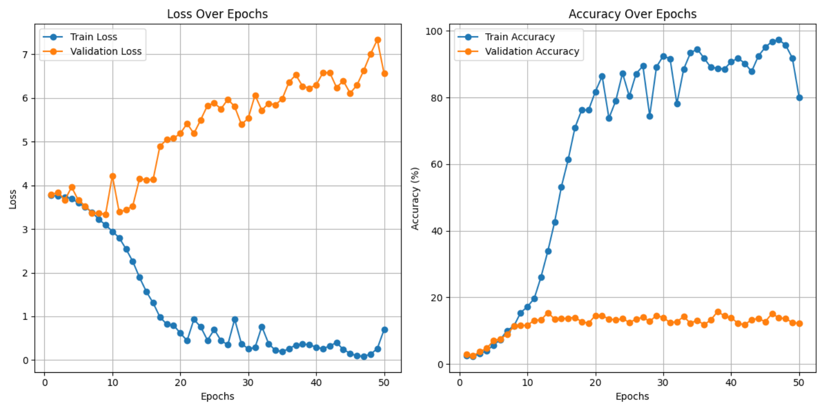
02 LeViT Based Approach
LeViT + FLatten Transformer
Replaced the attention block with focused linear attention.
Overfitting occurred, like the case with Swin + FLA.

Slide 8
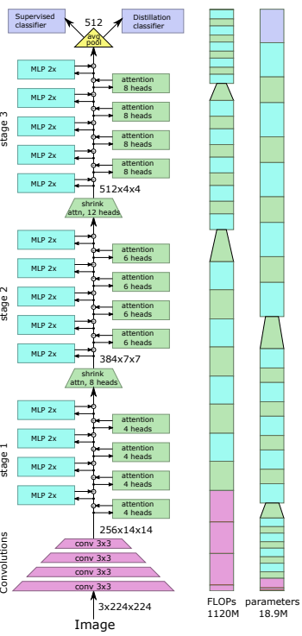
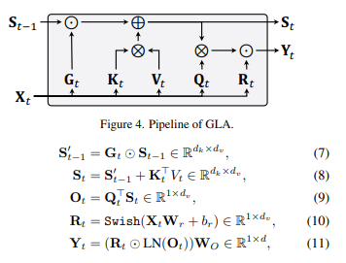
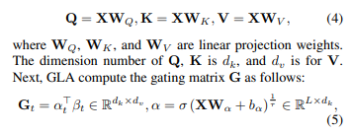

02 LeViT Based Approach
LeViT + GLA(Gated Linear Attention)
+
※⊙ is the element-wise multiplication operation
Similar to LSTM, GLA also uses a gating mechanism.
However, GLA achives computational efficiency by employing parallelized linear attention.
So we had replaced Attention blocks to GLA blocks to improve inference time.

Slide 9
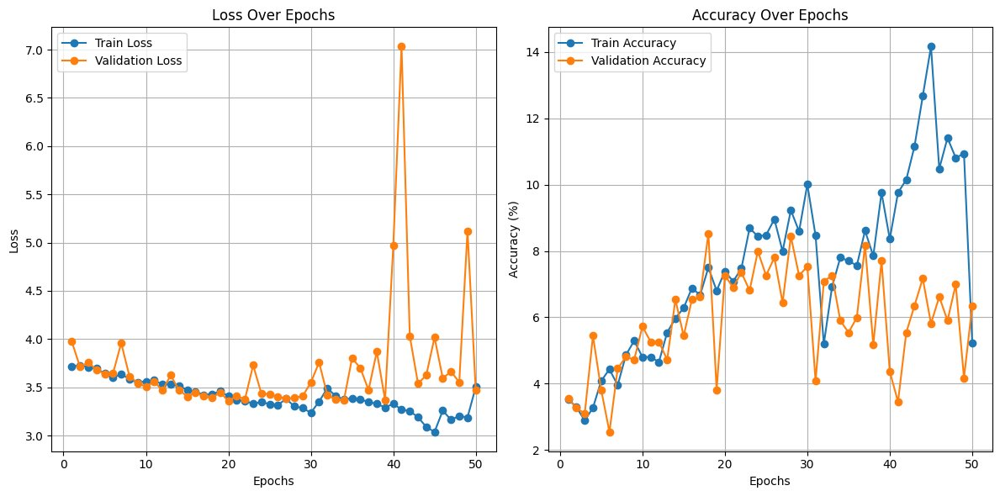
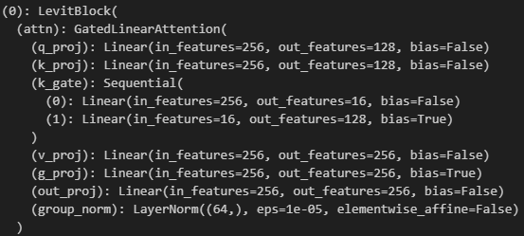
02 LeViT Based Approach
LeViT + GLA
LeViT_GLA's Average Inference Time = 14.13 ms
replace attention mechanism to GLA
Although the inference time has improved
compared to the original LeViT as shown in the plot above,
there is an extreme change in loss after 40 epochs,
and the accuracy also exhibits inconsistency.

Slide 10
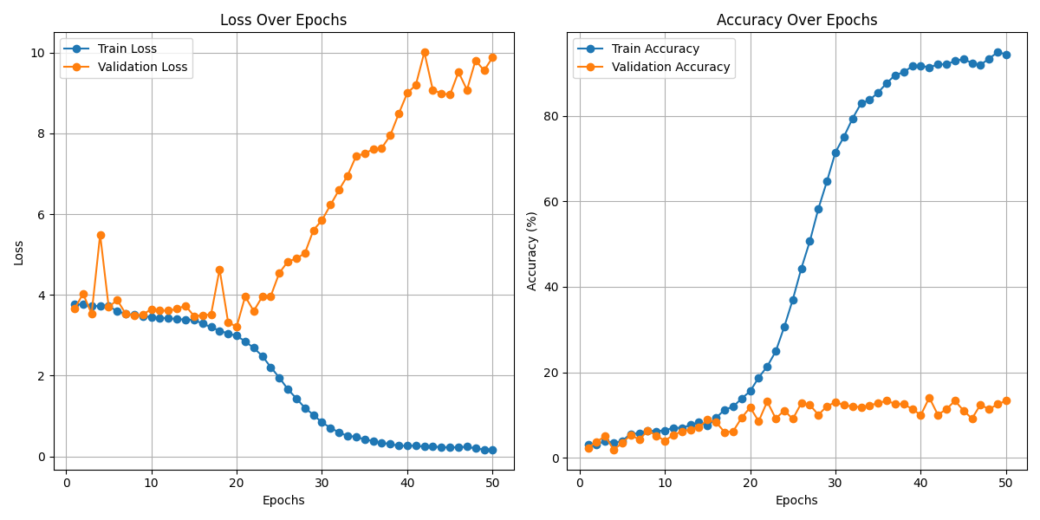
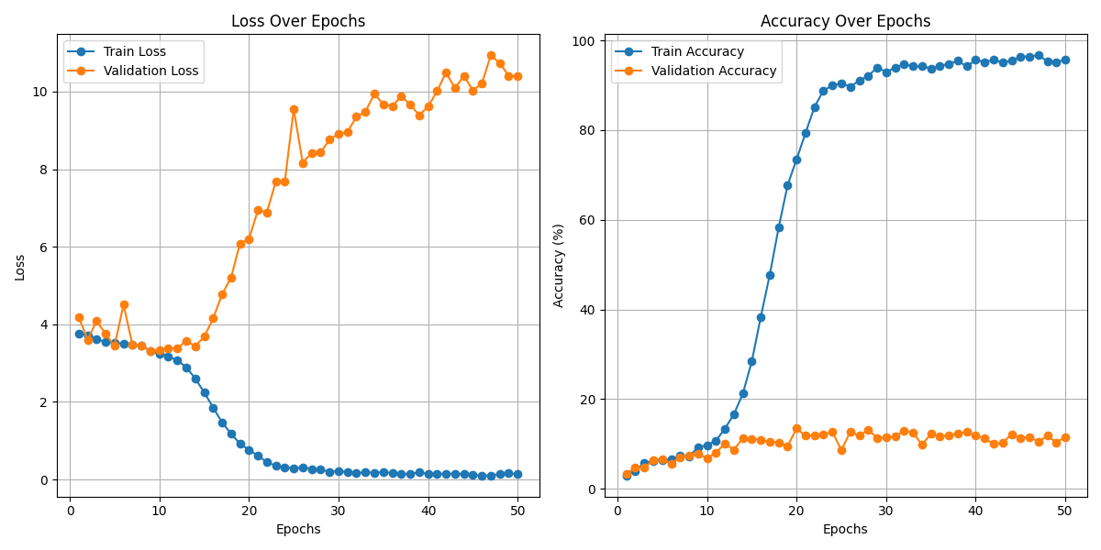

02 LeViT Based Approach
Unlike Swin + Similarity
LeViT + Similarity
Set | Result
LeViT + Jaccard
LeViT + Euclidian
Same as Swin + Similarity
Change similarity of Q and K Measurement of Attention
Jaccard similarity function
Euclidian similarity function
Average inference time : 84.42ms
Average inference time : 42.36ms
Original LeViT Average inference time : 16.29ms
Notes:
Swin에서 inference 시간이 줄어든 것을 토대로 LeViT에도 적용을 해봄
자카드, 유클리디안 모두 추론 시간이 많이 늘어남. 따라서 안쓰기로 결정.

Slide 11
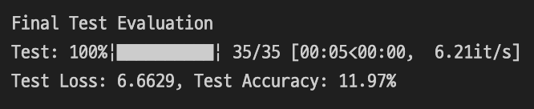
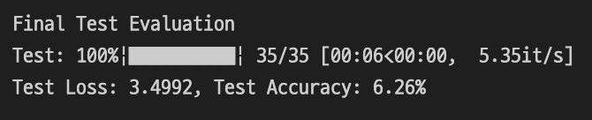
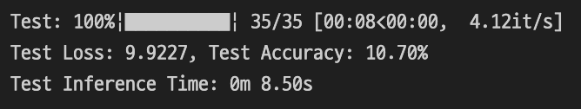

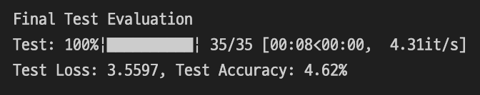
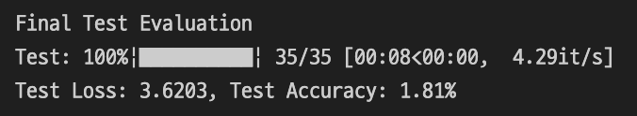
03 Launcher Architecture
Minimum Performance guaranteed
Apart from the inference time, the overall accuracy was low
when trained without hyperparameter tuning at 50 epochs.
LeViT + FLA implement
LeViT + GLA implement
LeViT + Jaccard implement
If it is a problem with model architecture, it should be well trained for verified models taken from timm.
However, we can also see that the model taken from timm is also poorly trained
when it is trained for 50 epochs in same dataset.
ResNet50 from timm
ViT from timm
SWIN from timm

Slide 12

03 Launcher Architecture
Minimum Performance guaranteed
Our Architecture
Our Architecture
Pretrained
ResNet50
(Freezed)
Pretrained ResNet50
It's impossible to train with larger dataset on Colab.
So, we had to find another way to show that our model accuracy is guaranteed.
Pre-trained ResNet50 was placed in front of the architecture to maintain the accuracy.
We decided to call the model with pretrained ResNet50 as Launcher.

Slide 13
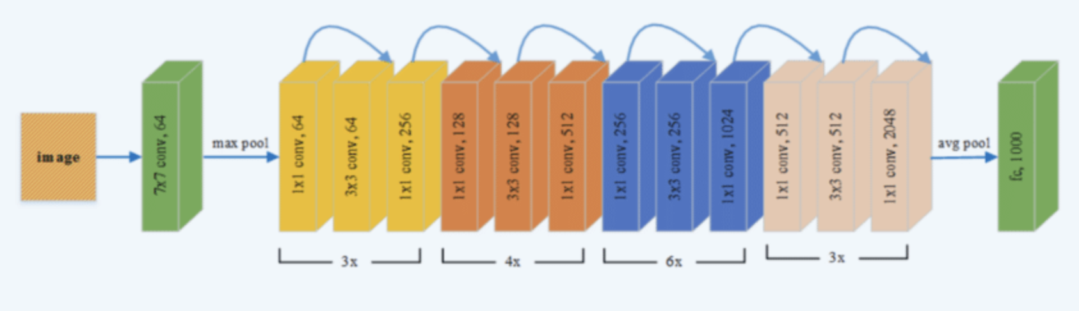
03 Launcher Architecture
Minimum Performance guaranteed
Conv(2048, input_shape)
Our Architecture

Slide 14
03 Launcher Architecture
Minimum Performance guaranteed
 | LeViT implement | L_LeViT implement | L_LeViT + FLA | L_LeViT + GLA | L_LeViT + Jaccard
Top-1 Acc | 2.81% | 83.59% | 84.30% | 49.32% | 86.49%
Loss | 3.9639 | 0.8333 | 0.7668 | 2.8617 | 0.8176
In the case of the Launcher with pre-trained ResNet50, we can see that accuracy is increased except for GLA.
This shows that the architecture we proposed does not lose class information.
For GLA however, it seemed prior class knowledge extracted by ResNet50 is lost during the process.
Technically, even though the Launcher model guarantees accuracy,
it does not mean that the architecture guarantees accuracy in full tuning.
It means that the architecture implemented in an environment with limited datasets
does not compromise the pre-learned information.
Therefore, we will show that the accuracy is guaranteed using the Laucher model in a limited environment
and try to compare the inference time.

Slide 15
04 New Ideas
IDEAS
None of the FLA, GLA, and similarity methods had a significant improvement on the inference time.
So we have experimented with 5 ideas below.
Replaced some of the attention Blocks with ConvNd layer.
Checkerboard masking for attention input.
Decreased the number of attention blocks.
Changed attention-based downsampling block to convolution-based downsampling block.
Applied Dropout.

Slide 16
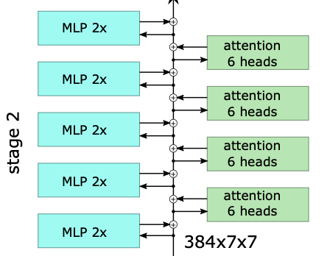
04 New Ideas
Input (384 channels)
|
+--------------------+
| Conv2d | Kernel: 1x1, Stride: 1, Padding: 0
| (384 -> 512) |
+--------------------+
|
+--------------------+
| BatchNorm2d |
+--------------------+
|
+--------------------+
| ReLU |
+--------------------+
|
+--------------------+
| Conv2d | Kernel: 1x1, Stride: 1, Padding: 0
| (512 -> 512) |
+--------------------+
|
+--------------------+
| BatchNorm2d |
+--------------------+
|
+--------------------+
| ReLU |
+--------------------+
|
Output (512 channels)
1. 1x1 Conv
We replaced the attention block with Conv with matching input/output channel size.
Conv-Batch-ReLU is composed of one block. (Using 1x1 Conv)

Slide 17
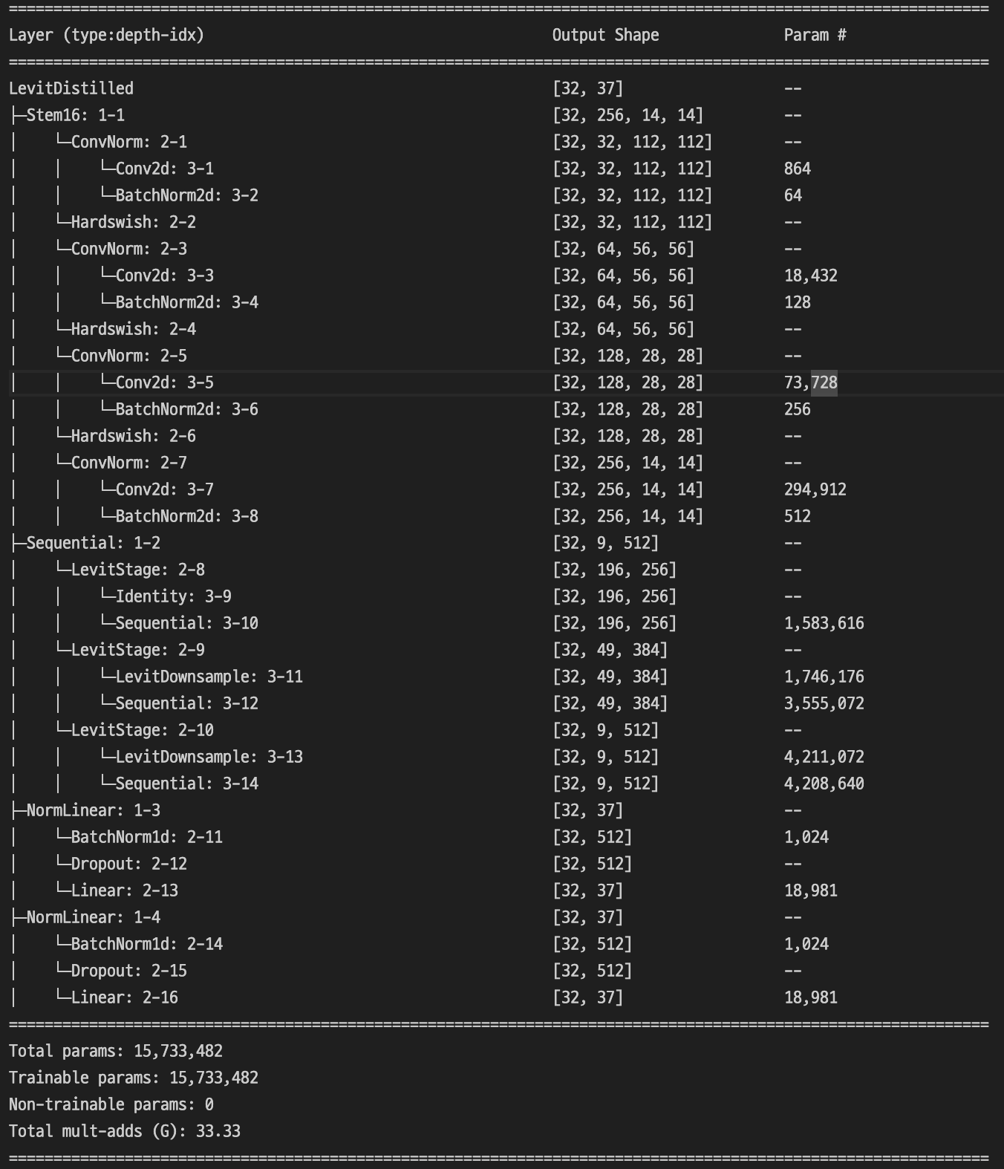

04 New Ideas
1. 1x1 Conv
LeViT has stages including three attention blocks.
Stages 1 ~ 3 were compared with each other,
by replacing them with Conv respectively.
 | Control Group(L_LeViT) | Stage1 -> 1x1 Conv | Stage2 -> 1x1 Conv | Stage3 -> 1x1 Conv
Conv Block Param | - | 395,776 | 790,272 | 921,600
Top-1 Acc | 83.59% | 1.54% | 86.22% | 82,77%
Inference Time | 22.52ms | 19.21ms | 22.92ms | 21.14ms
stage1
stage2
stage3
By replacing the first stage with Conv,
model cannot extract features properly,
affecting the lower layer and showing a low accuracy.
Replacing stage 3 is faster, while maintaining accuracy.

Slide 18
04 New Ideas
1. 1x1 Conv
 | Control Group(LeViT) | Stage3 -> 1x1 Conv
Inference Time | 10.50ms | 7.94ms
Additionally, we compared vanilla LeViT model with the modified one,
which still showed faster inference time.

Slide 19

04 New Ideas
2. Checkerboard Masking
Checkerboard
mask
5 3 8 7 9
4 6 2 5 1
9 8 7 6 4
3 2 5 8 7
6 4 9 3 1
1 0 1 0 1
0 1 0 1 0
1 0 1 0 1
0 1 0 1 0
1 0 1 0 1
5 0 8 0 9
0 6 0 5 0
9 0 7 0 4
0 2 0 8 0
6 0 9 0 1
 | Control Group(LeViT) | Masked LeViT
Inference Time | 10.50ms | 11.55ms
element-wise
multiplication
=
We thought masking the input to the attention block would reduce computation.
However, when we applied masking, it became slightly slower.
This could be because creating and applying the masking added extra computational overhead.
Notes:
since images are redundant maybe masking makes the process faster?

Slide 20
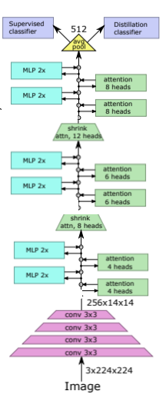

04 New Ideas
Num of blocks Stage1 + 2 + 3 | Result
Original LeViT 3 + 3 + 2
Original LeViT 2 + 2 + 2
3. Reduce number of blocks
 | Control Group(L_LeViT) | Control Group (LeViT)
Conv Block Param | - | 15,733,482
Top-1 Acc | 83.59% | 2.81%
Inference Time | 22.52ms | 10.50ms
 | L_2Blocks | 2Blocks
Conv Block Param | 56,805,757 | 14,020,586
Top-1 Acc | 85.77% | 13.78%
Inference Time | 20.92ms | 8.74ms
Reduce
When we reduce # of blocks(3 → 2) per stage
both accuracy and inference speed increased.
Original LeViT
2 Blocks (per each stage)
Notes:
LeViT에는 3, 3, 2개씩 attention 블럭이 있는데 너무 많은 attention 블럭은 오히려 과적합 위험이 있어서 줄여도 된다 생각하여, block수를 줄이면서 모델의 연산 복잡도를 줄여서 추론시간을 확인해봤다.
그래서 2, 2, 2개 씩 줄여본 결과 앞에 런처를 붙였을 때는 inferrence time이 2ms 정도 줄어지고, 정확도도 오히려 개선
런처를 안붙였을 때는 오히려 2ms정도 줄어들고, 이것도 정확도가 예상한대로 더 많이 개선

Slide 21
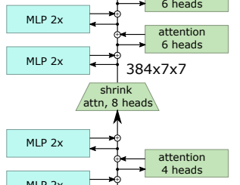
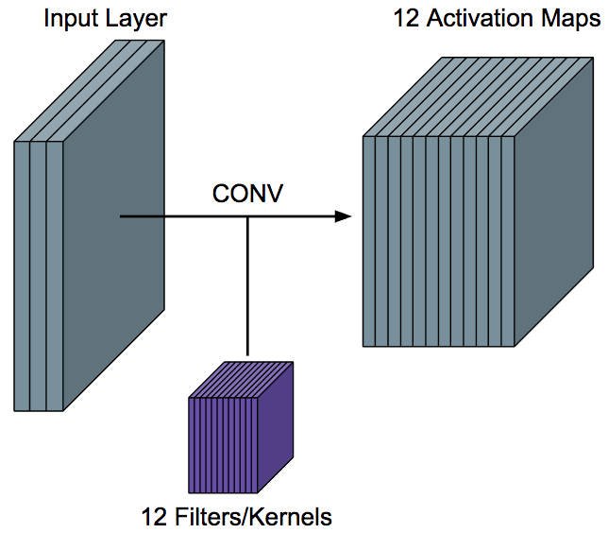
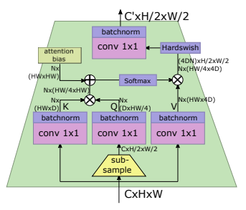
04 New Ideas
LeViT has a shrink attention block to downsample data.
The reason of downampling data is to connect stage and stage.
4. Change Attention of Downsampling layer to Conv
LeViT already has many attention calculation.
As reducing attention block showed better performance,
Higher attention computation cost = lower performance
So, we changed the Downsampling layer to Conv.
 | Control Group(L_LeViT) | Control Group(LeViT) | L_downsample with Conv | Downsample with Conv
Conv Block Param | - | 15,733,482 | 55,216,509 | 12,431,338
Top-1 Acc | 83.59% | 2.81% | 86.22% | 22.76%
Inference Time | 22.52ms | 10.50ms | 19.27ms | 9.70ms
When we relplace downsampling layer to Conv
It showed the inference speed has increased and the accuracy has also increased
Notes:
원래 LeViT 모델은 stage와 satge사이를 넘어갈 때 다운샘플링을 하는데, 이때 query의 크기를 절반으로 줄인 shrink transformer를 사용,
이것을 kerner size = 3, stride = 2, padding = 1을 사용하여 conv 연산을 이용한 다운샘플링을 시도하여 inference 시간을 줄여볼려고 시도
그 결과, 런처 붙어있을때는 acc도 3프로정도 늘어나면서 시간이 3ms 정도 줄어듬.
런처가 없을 때는 성능도 크게 늘어나고 추론시간도 1ms 정도 줄어듬

Slide 22
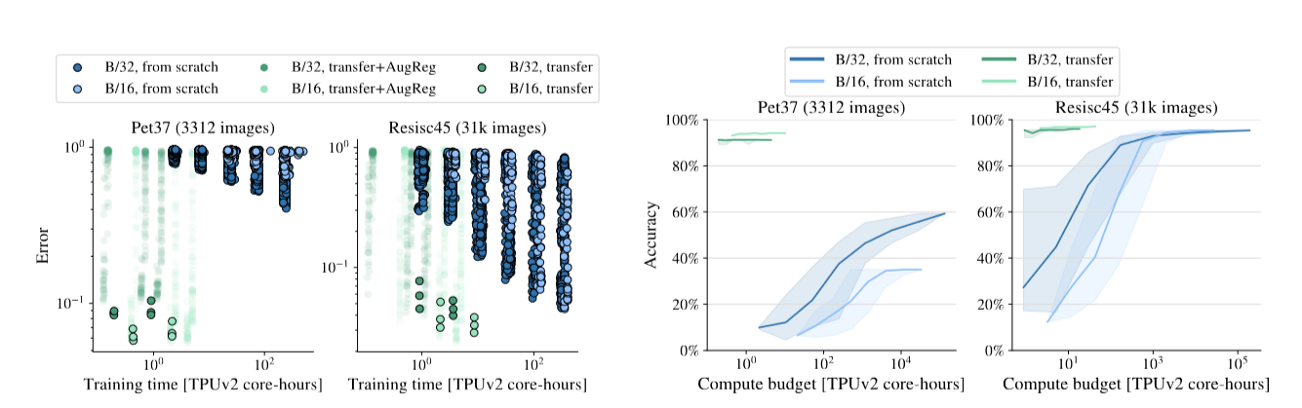
Q: “Is it right to add pretrained models beforehand?”
* How to train your ViT? Data, Augmentation, and Regularization on Vision Transformers – Steiner et al., IEEE TMLR 2022
Previous research confirmed that with small datasets, it is impossible to obtain generic models.
Model trained from scratch with small datasets can’t reach accuracies
anywhere near the model compared with the larger datasets/transferred model.
Therefore, we added pretrained ResNet50 prior to our architecture input for improving accuracy.
Notes:
So the question arises, is it right to add pretrained model prior to our proposed model?
if the model fails to train, is it because we did not set the environment, params, hyperparams, etc., properly?
If so, then our research is theoretically incorrect to add pretrained model, instead of tuning the proposed model for higher acc?
We have found the following paper from IEEE TMLR 2022, which has a great summary on training ViT models.
In this research, when training on Pet37 datasets, which we were training from, are not trainable from scratch, even with the high-end GPU/TPUs.
It was empricially concluded that the ViT model cannot obtain generic expressions of the given dataset when the size is not big enough.
So the authors have concluded that transferring the models pretrained from the similarly distributed dataset can be correctly trained.

Slide 23

05 Conclusion
Why HoViT?
To improve inference time
while maintaining and/or increasing performance of the vision transformer,
We made a new (ViT based) deep learning model.
HoViT → LeViT + Replacing some Attention block to Conv (1 X 1 Conv)
+ Reduce number of attention blocks (2 + 2 + 2)
+ Use Conv at Downsampling layer
Highly shrunk & optimized Vision Transformer – HoViT
Small but Fast..

Slide 24
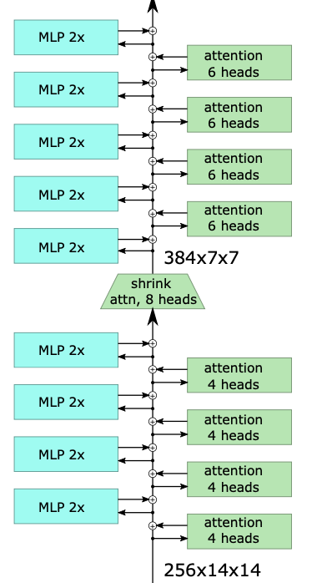
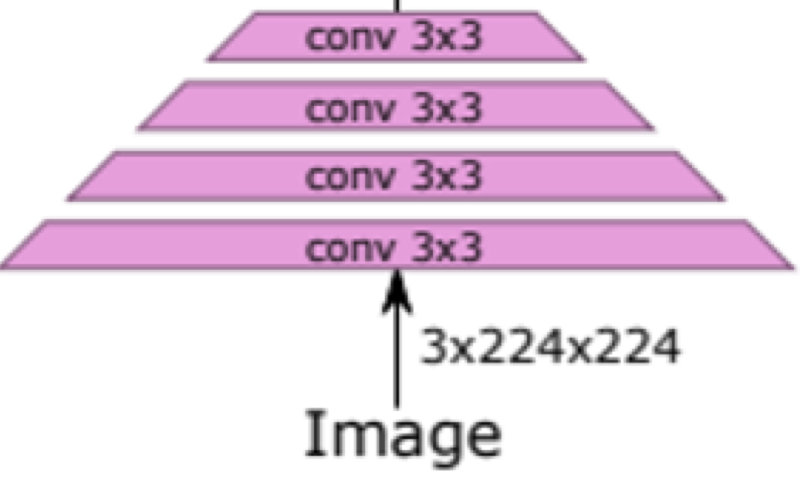
Supervised
classifier
Distillation
classifier
05 Conclusion
avg
poll
HoViT Architecture
1x1 Conv
512, 512
1x1 Conv
384, 512
Reduce Block#
MLP 2x
Attention
6 heads
MLP 2x
Attention
6 heads
3x3 Conv
256, 384
MLP 2x
Attention
4 heads
MLP 2x
Attention
4 heads

Slide 25
Supervised
classifier
Distillation
classifier
05 Conclusion
avg
poll
HoViT Architecture
1x1 Conv
512, 512
1x1 Conv
384, 512
Introduce Conv DownSampling
MLP 2x
Attention
6 heads
MLP 2x
Attention
6 heads
3x3 Conv
256, 384
MLP 2x
Attention
4 heads
MLP 2x
Attention
4 heads

Slide 26
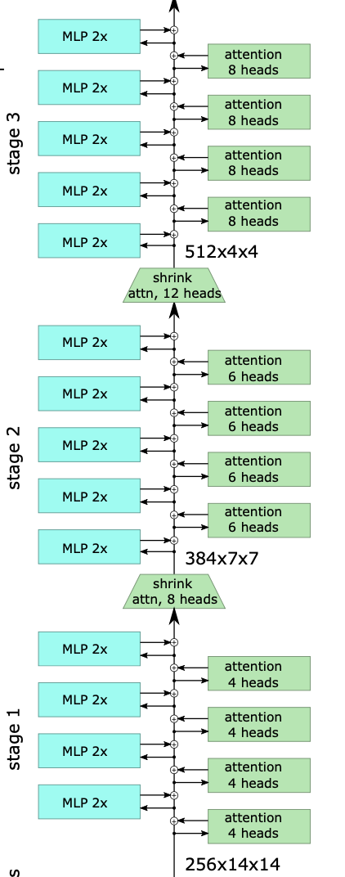
Supervised
classifier
Distillation
classifier
05 Conclusion
avg
poll
HoViT Architecture
1x1 Conv
512, 512
1x1 Conv
384, 512
Replace Shrink & Stage3 to 1x1 Conv
MLP 2x
Attention
6 heads
MLP 2x
Attention
6 heads
3x3 Conv
256, 384
MLP 2x
Attention
4 heads
MLP 2x
Attention
4 heads

Slide 27
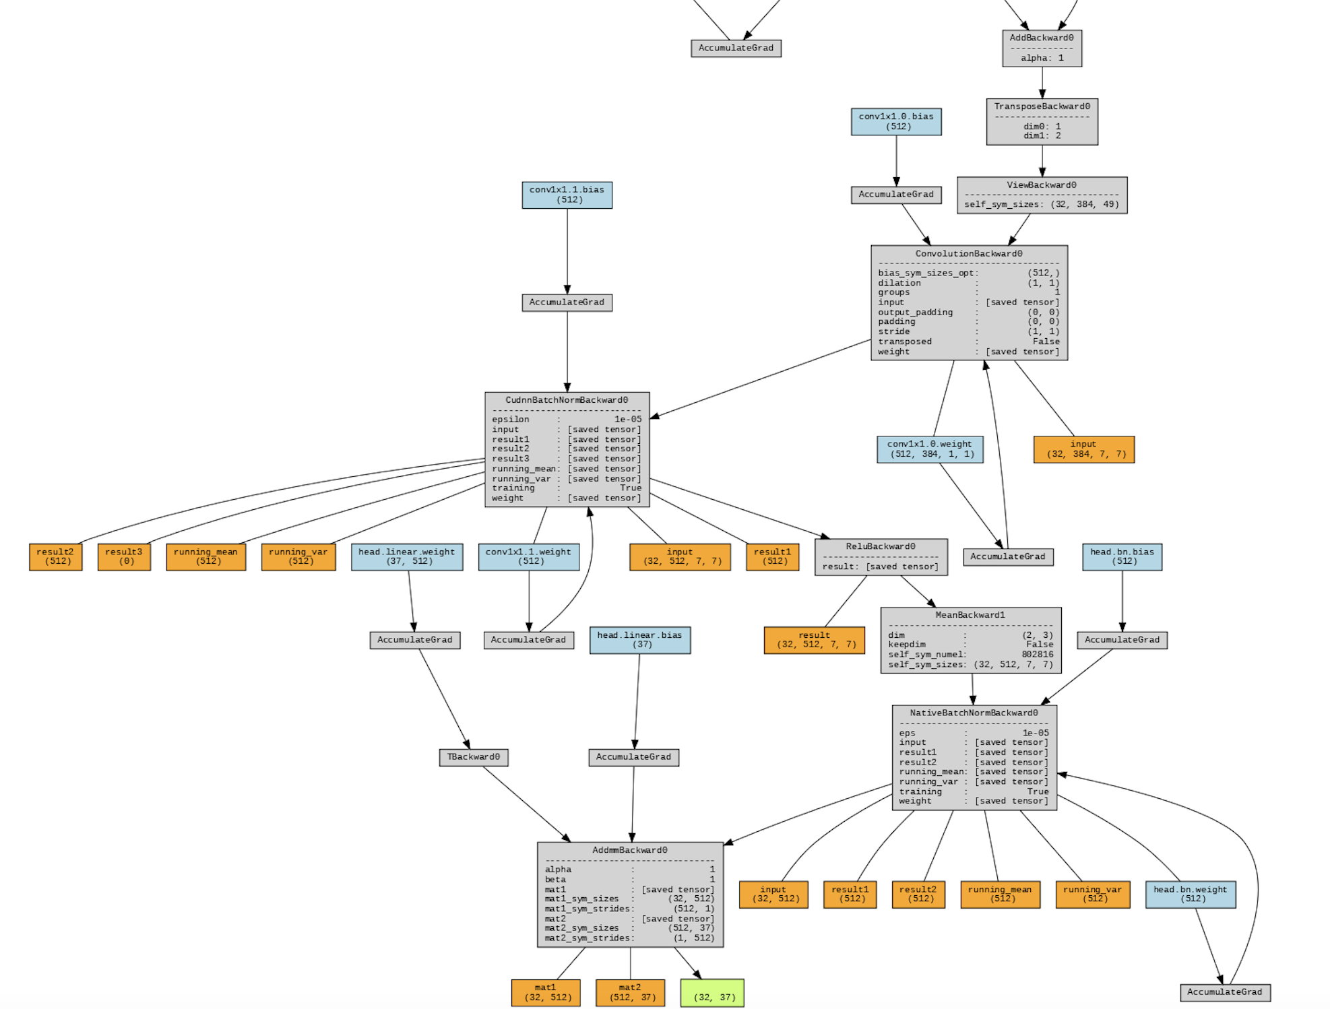
Supervised
classifier
Distillation
classifier
05 Conclusion
avg
poll
HoViT Architecture
1x1 Conv
512, 512
1x1 Conv
384, 512
MLP 2x
Attention
6 heads
MLP 2x
Attention
6 heads
3x3 Conv
256, 384
MLP 2x
Attention
4 heads
MLP 2x
Attention
4 heads

Slide 28
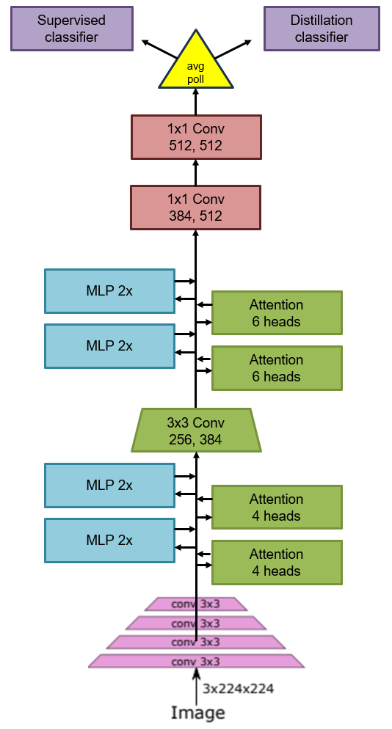
05 Conclusion
HoViT architecture compared with LeViT

Slide 29
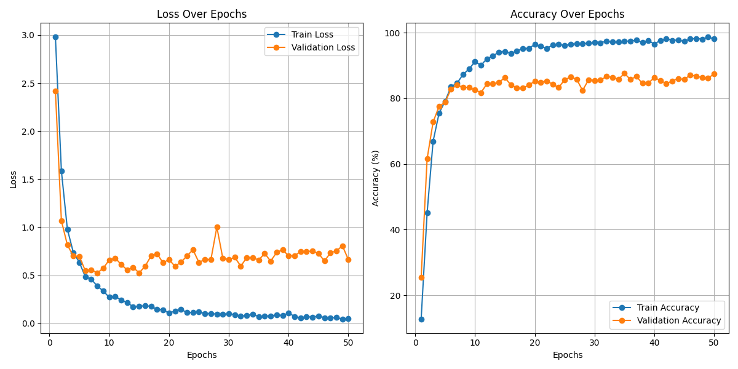
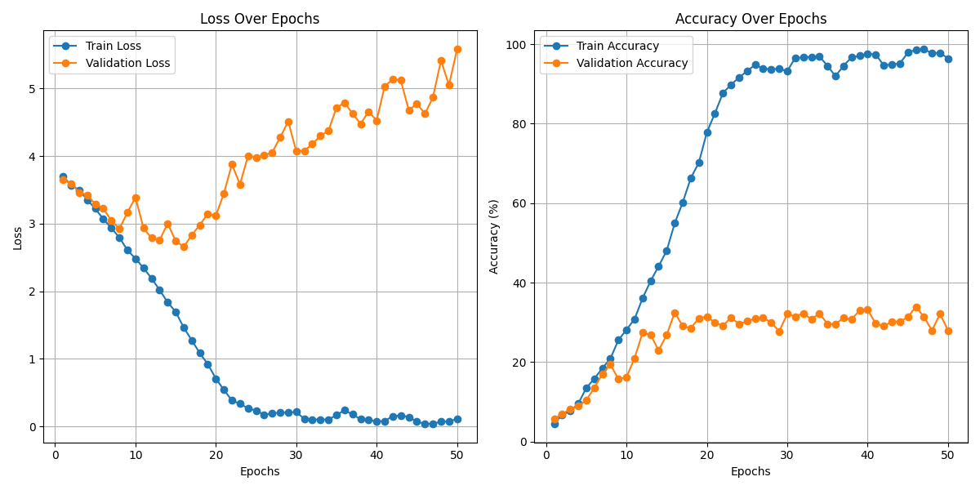
05 Conclusion
HoViT result
Oxford-IIIT Pet with 50 epochs
L_HoViT
HoViT
Loss : 0.7049
Acc : 85.13%
Acc : 27.47%
Loss : 5.5827
 | Control Group(L_LeViT) | Control Group(LeViT) | L_HoViT | HoViT
Conv Block Param | - | 15,733,482 | 47,723,133 | 4,937,962
Top-1 Acc | 83.59% | 2.81% | 85.13% | 27,47%
Inference Time | 22.52ms | 10.50ms | 18.47ms | 5.82ms
HoViT showed faster inference speed
while maintaining performance
Single model inference time
improved by 44.57%
Parameters have been reduced by 68.62%
Notes:
HoViT은 그림과 같이 추론 시간이 크게 줄어든 것을 확인 할 수 있음. 그러는 와중에 성능도 낮아진것이 아님. 추론속도가 기존 LeViT보다 45프로 정도 향상되고 파라미터도 68프로 정도 줄어들어 모델이 많이 경량화 된것을 확인할 수 있다.

Slide 30
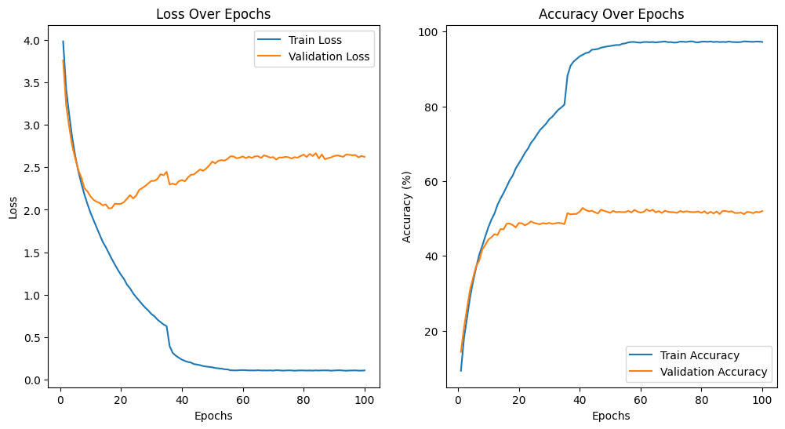
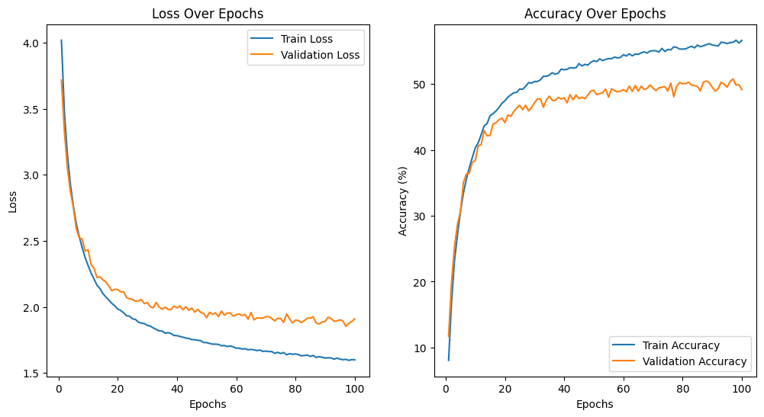
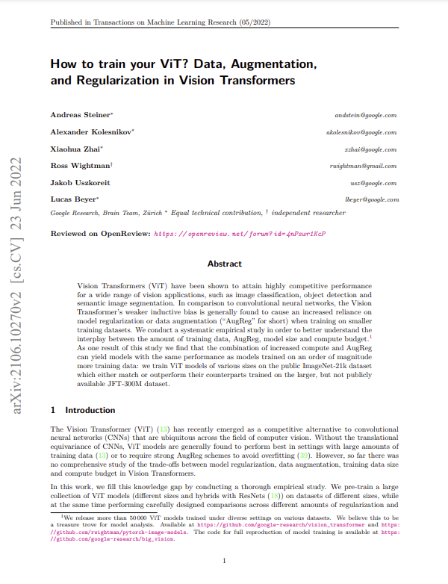
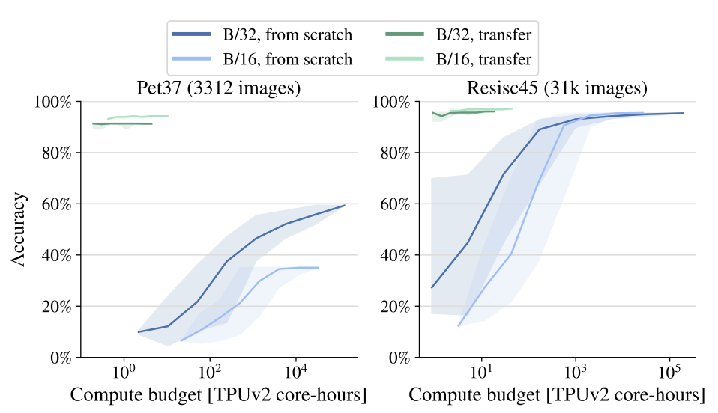
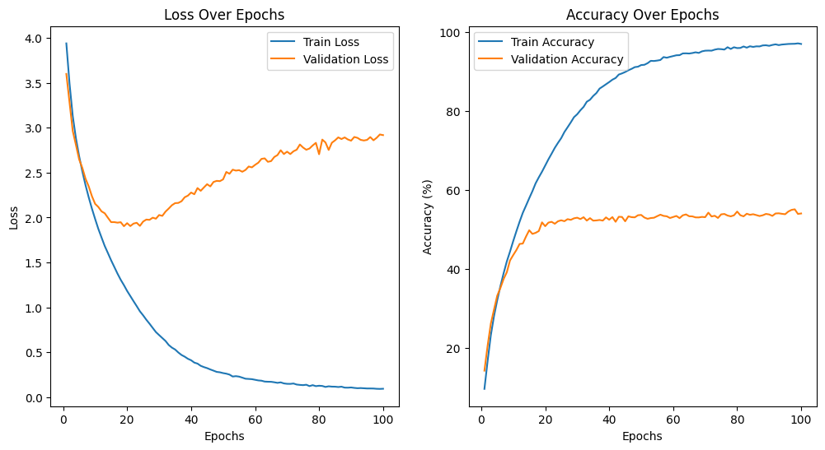
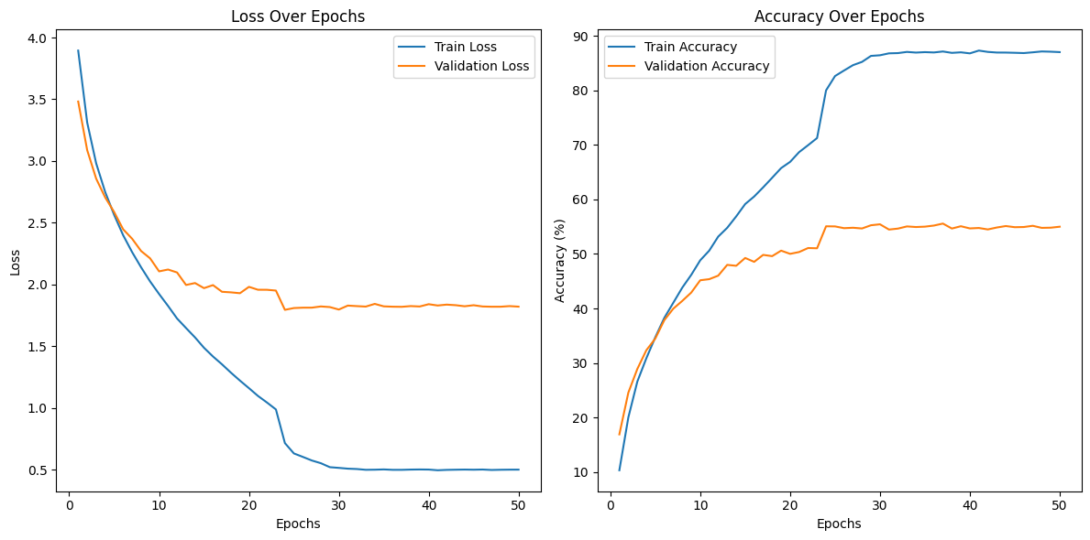
05 Conclusion
HoViT result
We tried CIFAR-100 dataset with 100 epochs
different learning rate, optimizer, scheduler, …
Tried CIFAR-100 with 100 epochs
Accuracy stopped between 50% ~ 60%
https://arxiv.org/abs/2106.10270
As shown in the paper mentioned above,
When you have a small dataset,
The ViT accuracy converges to around 50 or 60%.
Same symptoms with our proposed HoViT
So, we want to try with larger dataset (Like ImageNet)
Notes:
우리는 우리의 제한된 환경에서 최대한 HoViT의 성능을 파악하기 위해 다른 CIFAR 100 그리고 100epoch을 여러 lr, optimizer, scheduler을 사용해가면서 많이 시도해보았다.
그 결과 모두 acc가 50 퍼에서 60 퍼사이로 수렴한다. 앞에서 언급한 논문에서 볼 수 있듯이 제한된 데이터셋을 가지고 ViT를 학습하면 acc 가 50퍼에서 60퍼에서 수렴하게 된다고 했다. HoViT도 이와 비슷한 현상이 발견되었다.
따라서 우리는 더 이미지넷과 같은 더 큰 데이터 셋에서 결과를 확인해보고 싶다.

Slide 31
06 Future Work
Discussion and Future Direction
Jaccard Similarity
Computing attention with Jaccard similarity showed stable training even on small datasets.
However, it comes with a trade-off in terms of complexity.
It is expected to be applicable to architectures designed for small datasets.
GLA (Gated Linear Attention)
For GLA, while it shows potential (As a method originally proposed for diffusion models),
further experiments on larger datasets are necessary.
HoViT
For HoViT, additional ablation studies are required to evaluate its effectiveness thoroughly.

